Slide 1
Analysis of Data
IE300
Name:
Ebrahim Arian
Lab:
Tuesday 3:00 PM to 4:00 PM
Thursday 3:00 PM to 4:00 PM
Office Hour:
Tuesday 11:00 AM to 12:00 PM
Spring 2017

Slide 2
Group
Task
Problem
Solution
Group1:
Ashwath Srinivas
Arjit Jaiswal
Zack Jin
Group2:
Anthony Alvizu
Murtaza Zohair
Mohit Gayatri
Group3:
Justin Clark
Noel Brindise
Michael Brenner
Group4:
Ahsan Ali
Meehika Patel
Dominic Rossi
Group5:
Cameron Hartman
Bobby Morales
Edgar Garcia
Group6:
Thomas Liu
Ketan Patel
Ailian Wang

Slide 3
Group
Task
Problem
Solution
Group1:
Ross Sinar
Jake Maher
Zach Harris
Group2:
Mia Alvergue
Gabriel Silva
Curtis Schwarzkopf
Group3:
Pacharapol Charoensuk
Chandra Patel
Group4:
Jacob Stone
Maggie Naden
Jack Stecker
Group5:
Szymon Koszarek,
Patrick Hogan
Charles case
Group6:
Ashwin Udayaprakash
Grant Vogel
Rikin Mehta
Group7:
Jiahao Liu
Danny Hill

Slide 4
Task
Due of Second Case Study:
Feb 20, 2017 for Tuesday lab
Feb 22, 2017 for Thursday lab
Work As GROUP
printed copies of:
all code used to complete the case,
outputs generated by running their code with the given data sets, and
plots

Slide 5
Objectives of Second Case Study
The objectives are to:
Use Python to read and analyze data
Apply the concept of conditional probability and Bayes’ Theorem
Develop a simple Naive-Bayes classifier model using m-estimates

Slide 6
Objectives of Second Case Study
Predicting Delays
How can we use historical data to make predictions about delays?
We will study a very popular model in statistics and machine learning called Naive-Bayes

Slide 7

Bayes’ Theorem
Bayes’ Theorem

Slide 8

Naive-Bayes Classifier
Suppose we have a vector X = (x1, x2, ..., xn) representing n attributes (independent variables).
where Ck represents possible outcomes (classes)
If we are trying to decide whether a particular flight is likely to be delayed, the outcome would be from the set Ck ∈ {Y, N}

Slide 9
Naive-Bayes Classifier
pick the value Ck that is most probable
we pick the Ck that maximizes P (Ck|X)
P (X) will be the same for all possible classes
maximizes P(Ck ∩ X) or
P(Ck)P (Ck|X)

Slide 10
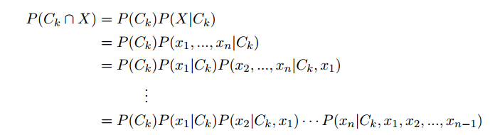
Naive-Bayes Classifier
P(Ck ∩ X) = P(Ck ∩ x1 ∩ x2 ∩ . . . ∩ xn)

Slide 11


Naive-Bayes Classifier
P(xi|Ck , xj) = P(xi|Ck) i is not j
P(Ck ∩ X) = P(Ck)P(x1 | Ck)P(x2 | Ck)…P(xn | Ck)
We assume conditional independence between each attributes

Slide 12
Naive-Bayes Classifier
DFW-LGA on Delta Delay or No-Delay

Slide 13

M-Estimates
The conditional densities P(xi|Ck) can be defined in different ways
where ˆn is the number of observations which C = Ck and X = xi
n is the number of observations C = Ck P(xi|Ck) = P(xi ∩ Ck)/P(Ck)

Slide 14

M-Estimates
we may find that ˆ n = 0 or n = 0
The idea behind m-estimates is to pretend we have m extra observations with class C = Ck, with m · p of them having attribute X = xi
p is p = 1/ (# of possible values for attribute i)

Slide 15
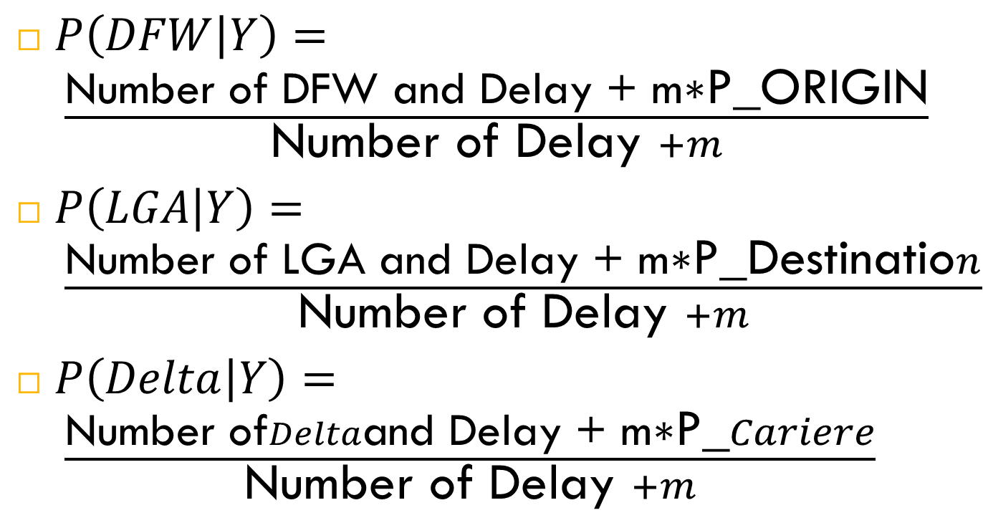
Naive-Bayes Classifier
$P\left(DFW | Y\right)= \frac{\text{Number} \text{of} \text{DFW} \text{and} \text{Delay}\text{ + }\text{m}\text{∗}\text{P}\text{_}\text{ORIGIN}}{\text{Number} \text{of} \text{Delay} +m}$
$P\left(LGA | Y\right)= \frac{\text{Number} \text{of} \text{LGA} \text{and} \text{Delay}\text{ + }\text{m}\text{∗}\text{P}\text{_}\text{Destinatio}n}{\text{Number} \text{of} \text{Delay} +m}$
$P\left(Delta | Y\right)= \frac{\text{Number} \text{of}Delta\text{and} \text{Delay}\text{ + }\text{m}\text{∗}\text{P}\text{_}Cariere}{\text{Number} \text{of} \text{Delay} +m}$

Slide 16
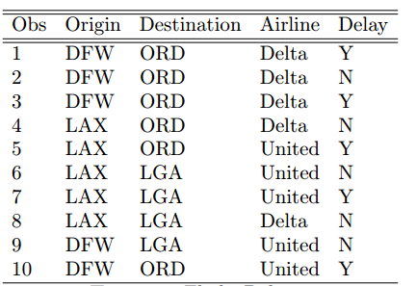
Example
classify DFW-LGA on Delta

Slide 17
Example
Which one is Maximum??

Slide 18
Exercise 3
2346 observations
JFK-LAS on American Airlines (AA)
JFK-LAS on JetBlue (B6)
SFO-ORD on Virgin Airlines (VX)
SFO-ORD on Southwest Airlines (WN)

Slide 19
JFK-LAS on American Airlines (AA)
JFK-LAS on American Airlines (AA)
Calculate the Number of JFK and Delay
Calculate the Number of JFK and No-Delay
Calculate the Number of LAS and Delay
Calculate the Number of LAS and No-Delay
Calculate the Number of AA and Delay
Calculate the Number of AA and No-Delay
Calculate the Number of Delay
Calculate the Number of No-Delay
Calculate the P_ORIGIN = 1/Number of Origins
Calculate the P_DESTINATION = 1/Number of destinations
Calculate the P_CARRIER = 1/Number of Carriers

Slide 20
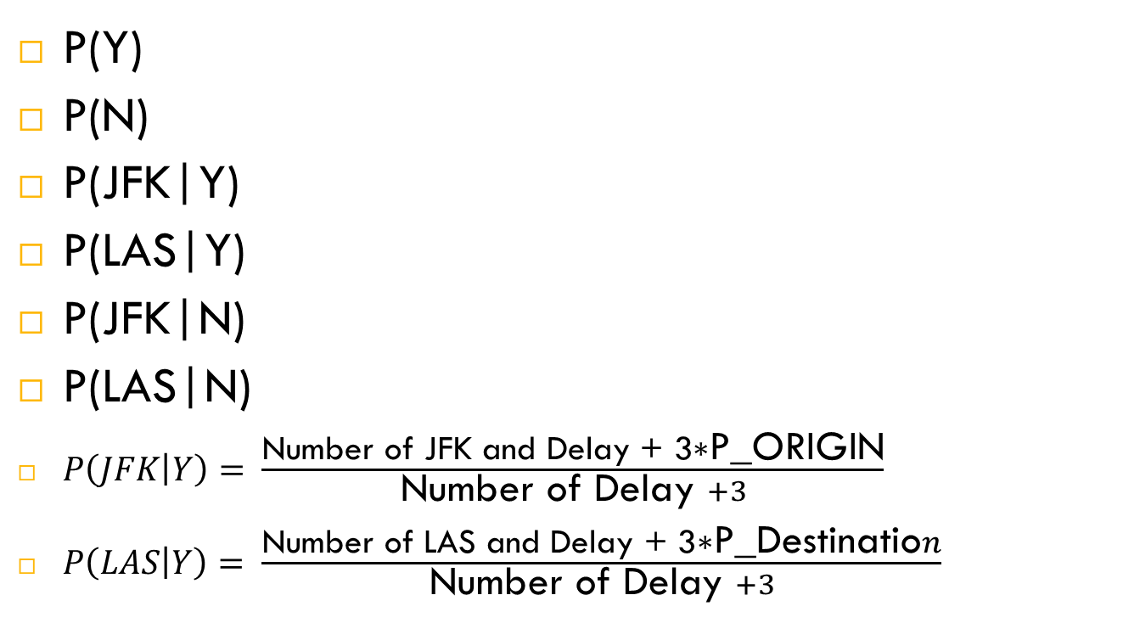
JFK-LAS on American Airlines (AA)
P(Y)
P(N)
P(JFK|Y)
P(LAS|Y)
P(JFK|N)
P(LAS|N)
$P\left(JFK | Y\right)= \frac{\text{Number} \text{of} \text{JFK} \text{and} \text{Delay}\text{ + 3∗}\text{P}\text{_}\text{ORIGIN}}{\text{Number} \text{of} \text{Delay} +3}$
$P\left(LAS | Y\right)= \frac{\text{Number} \text{of} \text{LAS} \text{and} \text{Delay}\text{ + 3∗}\text{P}\text{_}\text{Destinatio}n}{\text{Number} \text{of} \text{Delay} +3}$

Slide 21
JFK-LAS on American Airlines (AA)
P(Y|JFK,LAS,AA) = P(JFK|Y)P(LAS|Y)P(AA|Y)P(Y)
P(N|JFK,LAS,AA) = P(JFK|N)P(LAS|N)P(AA|N)P(N)
WHICH ONE IS MAXIMUM

